Slide 1

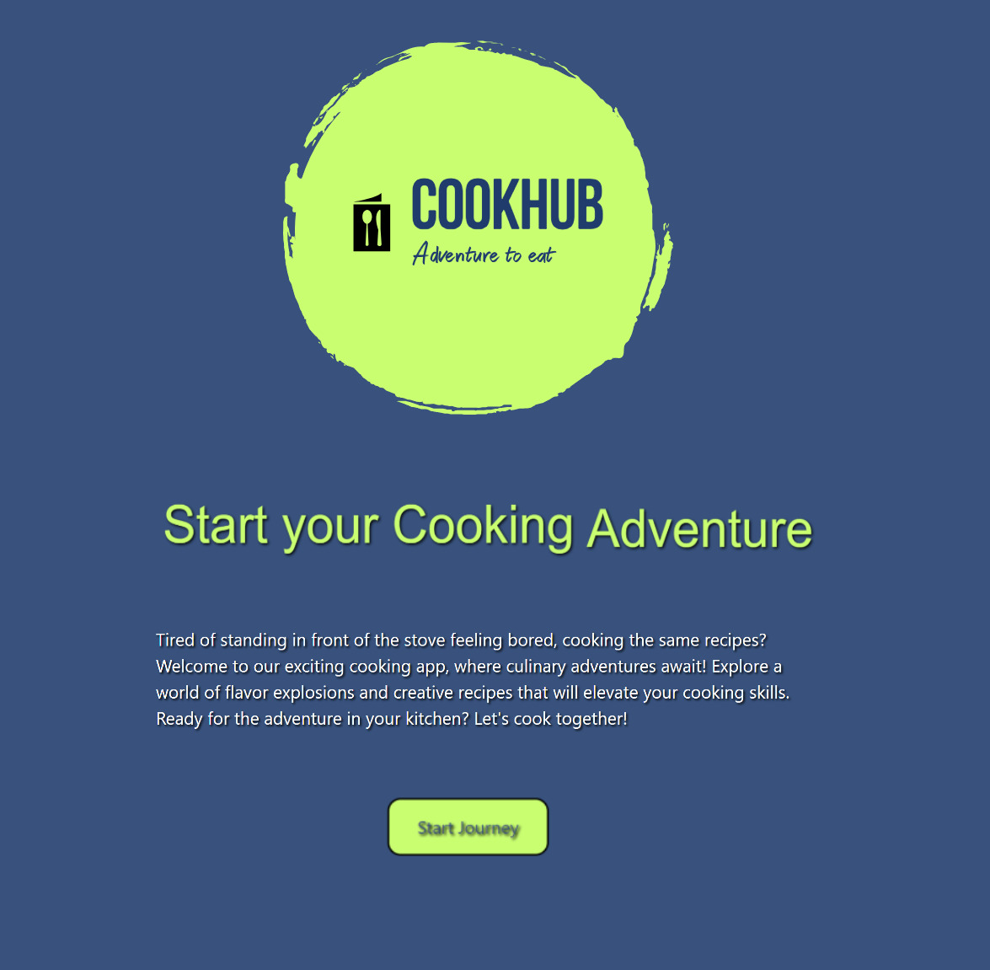
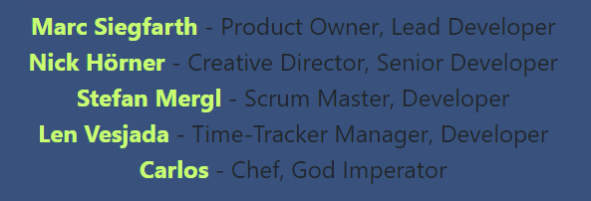


Slide 2

1 Project Goals & Vision
CookHub is envisioned to be an online recipe book designed to store its own recipes in a database and save custom-created recipes.
Additionally, the user can transforme recipes into an adventure by wrapping the cooking instructions into an automatically generated adventure story, making cooking a real experience.
The heart of this project is to provide fun at cooking.
Let‘s goooo!

Slide 3
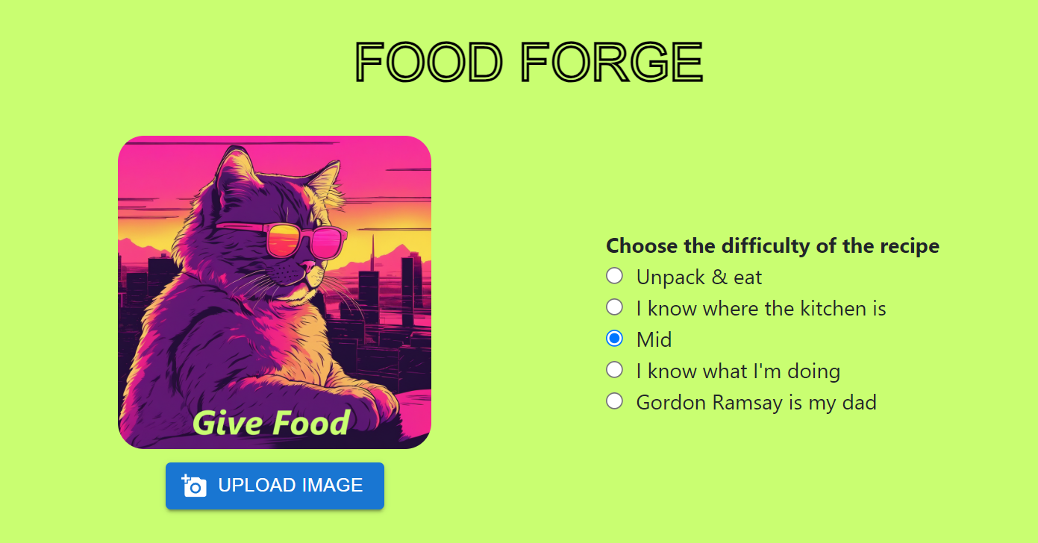
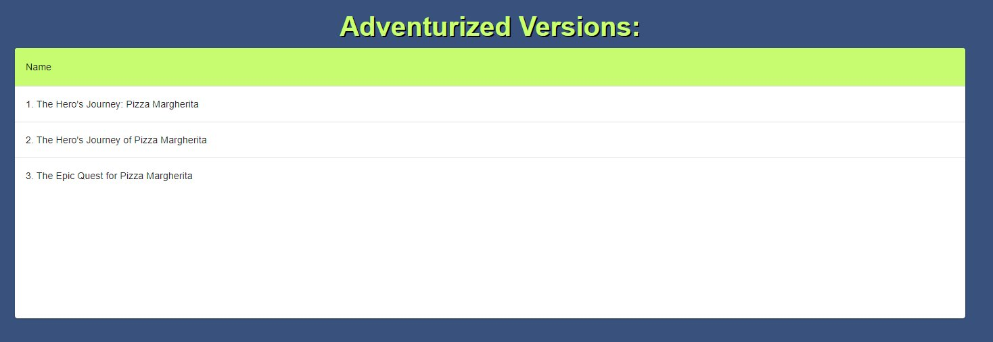
2.2 FoodForge
FoodForge is the base for the user to create a recipe and provides a detailed form to fill in instructions, ingredients and data like preparation, cooking time or difficulty.
2.1 Adventurize it Ⓒ
Adventurize it Ⓒ is our copyrighted shooting star and set to be our unique selling point for the app. It takes recipes, lists of ingrediences or even just descriptions of dishes and converts it into short adventure stories lifting cooking into a new sphere of enjoyable experience. Turn your next dinner into a hero saga or let your toddlers enjoy their first cooking experience by defeating the grumpy Bolognese-Dragon!
2.3 Fun CookHub is created to be fun to the user why we invented Carlos as our Chef and also tried to keep the content funny.
I am
THE selling point !

Slide 4

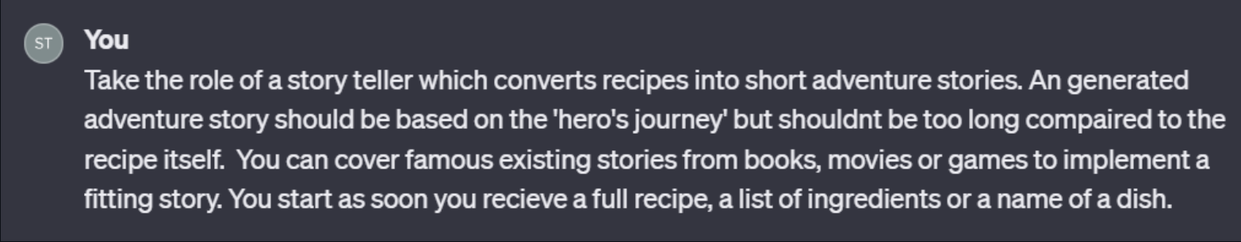
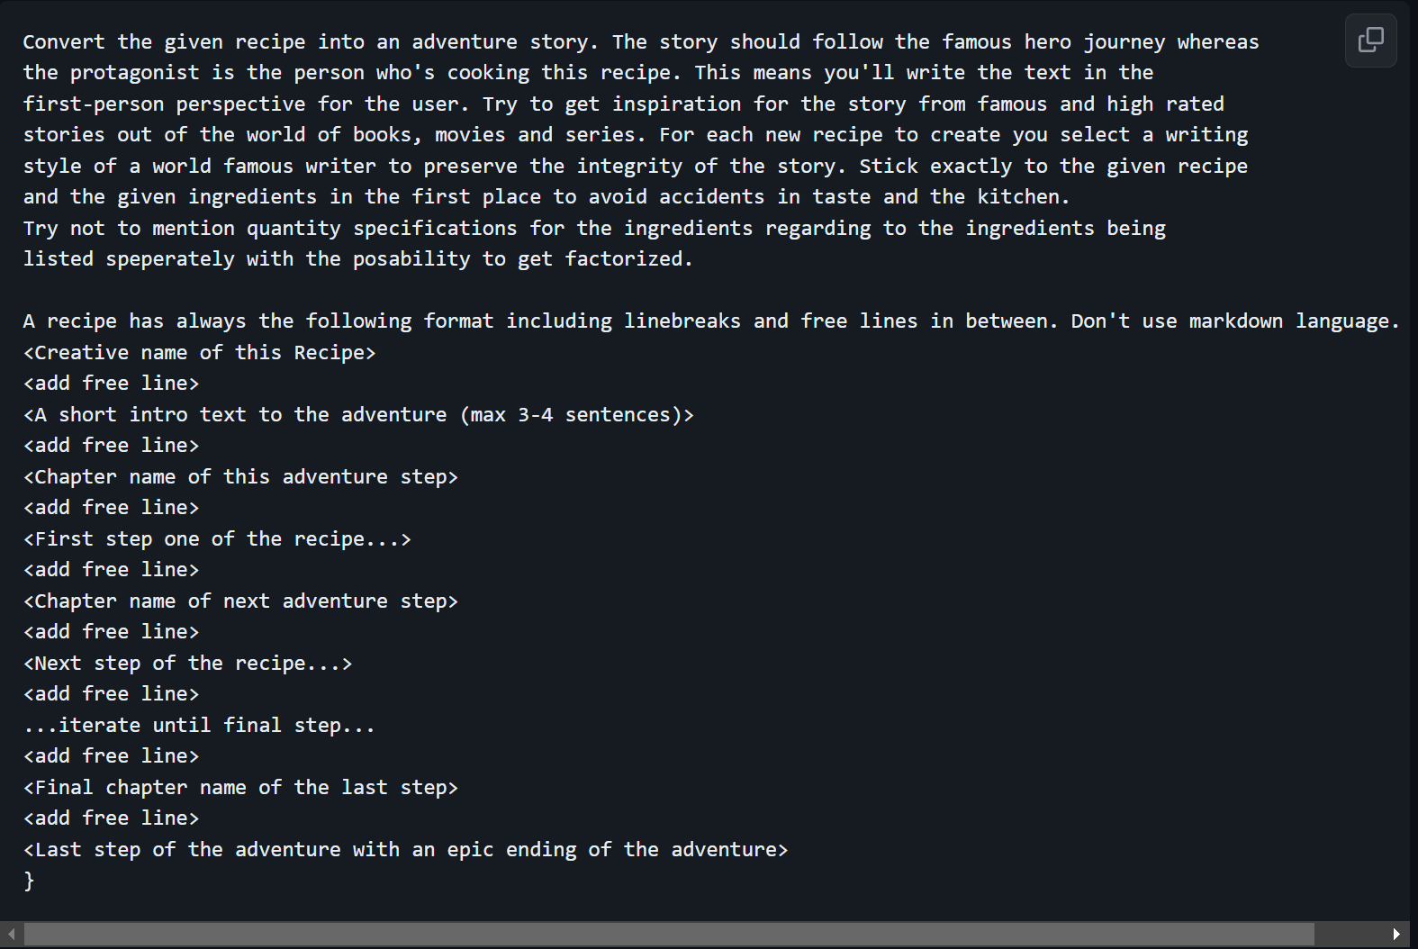
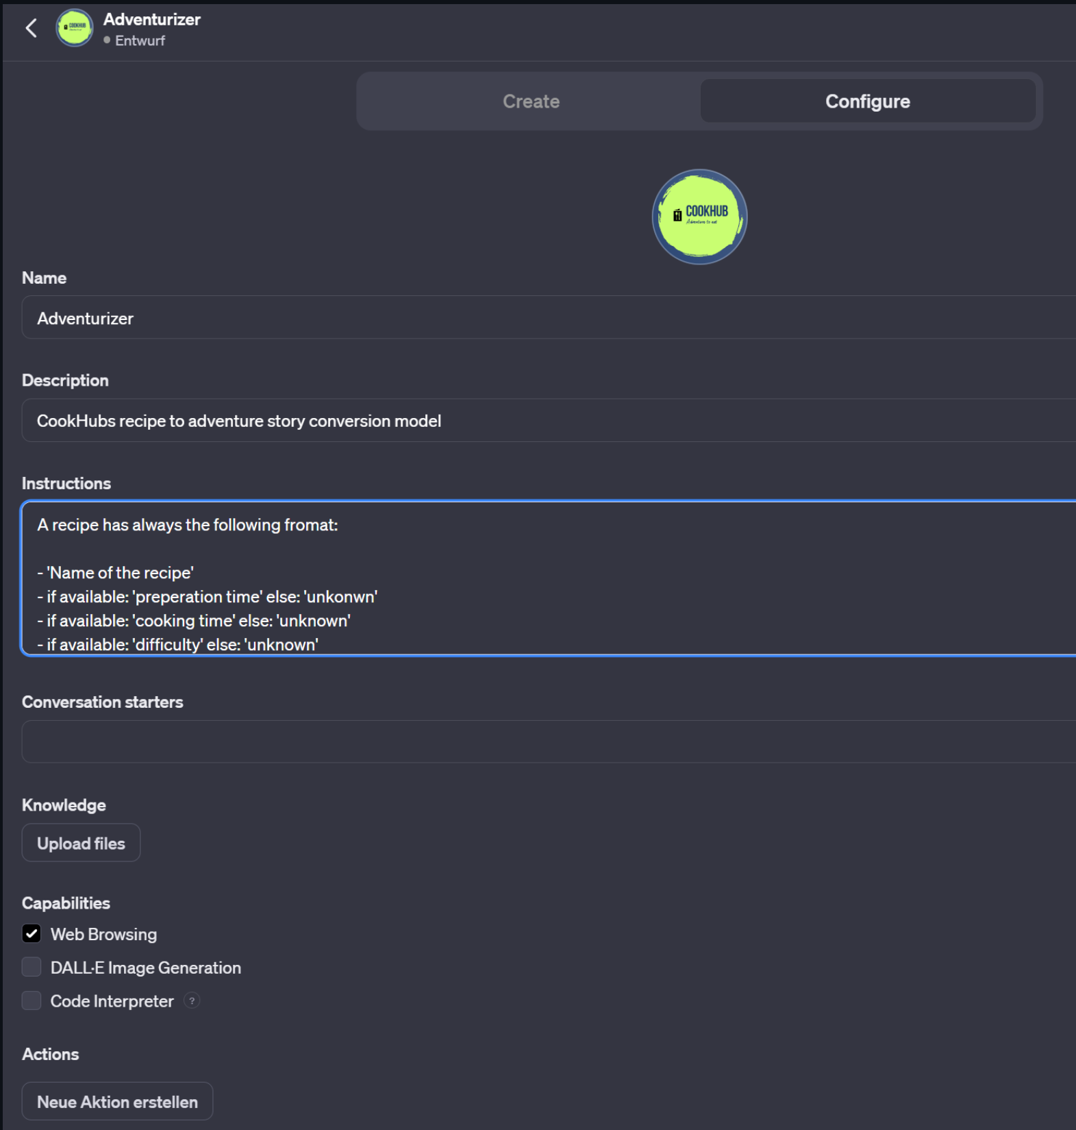
2.4 Prompt v0.5, v0.7, v1.0

Slide 5
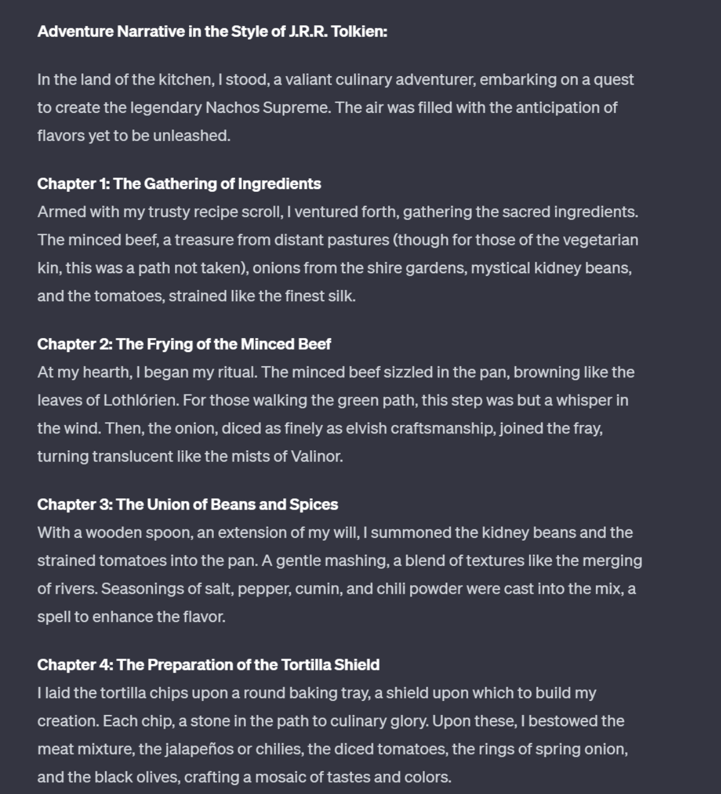
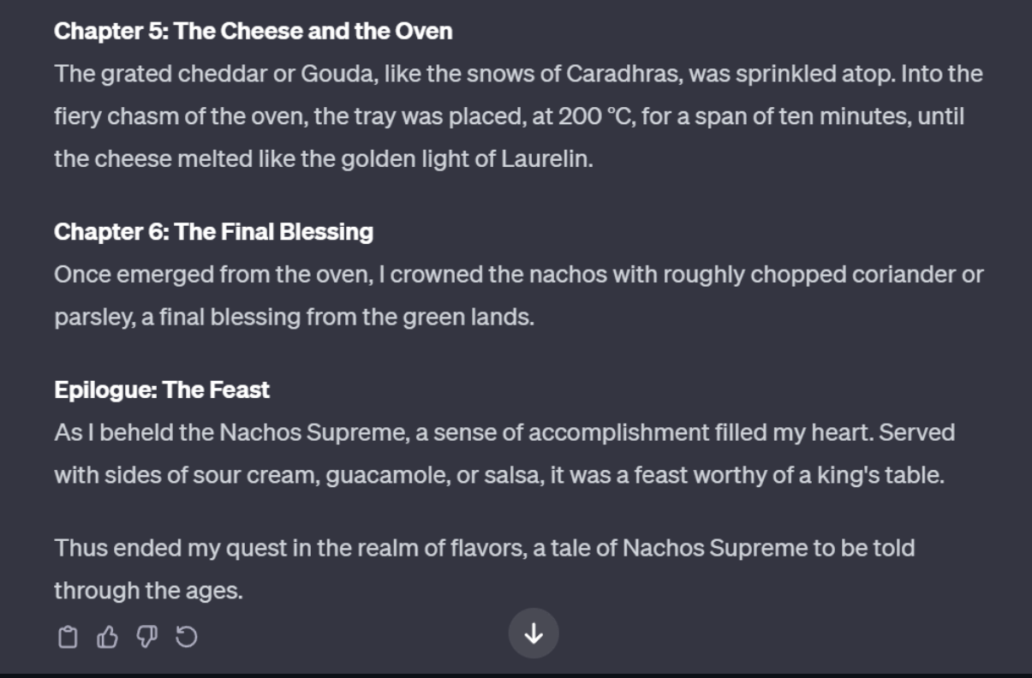
Legal notice: We'll probably have to talk to our legal department again about copyright. *cough*

Slide 6

3 Tech stack
CI / CD | PM – Tools | Frontend | Backend | Database | Work Techniques
- Git - Github Actions | - TMetric - Draw.io - Figma | - Typescript - React - Lacofy - Material UI - Jest - Selenium | - C# - ASP.NET - NHibernate - xUnit.NET - NSubstitute | - PostregSQL - SQLite | - Agile - Weeklys - Issue Tracking - Peer Review

Slide 7
4 Architecture
Decisions
Separation of Concerns
Modularity
Simplicity
Enhanced Security
Simplified Deployment

Slide 8
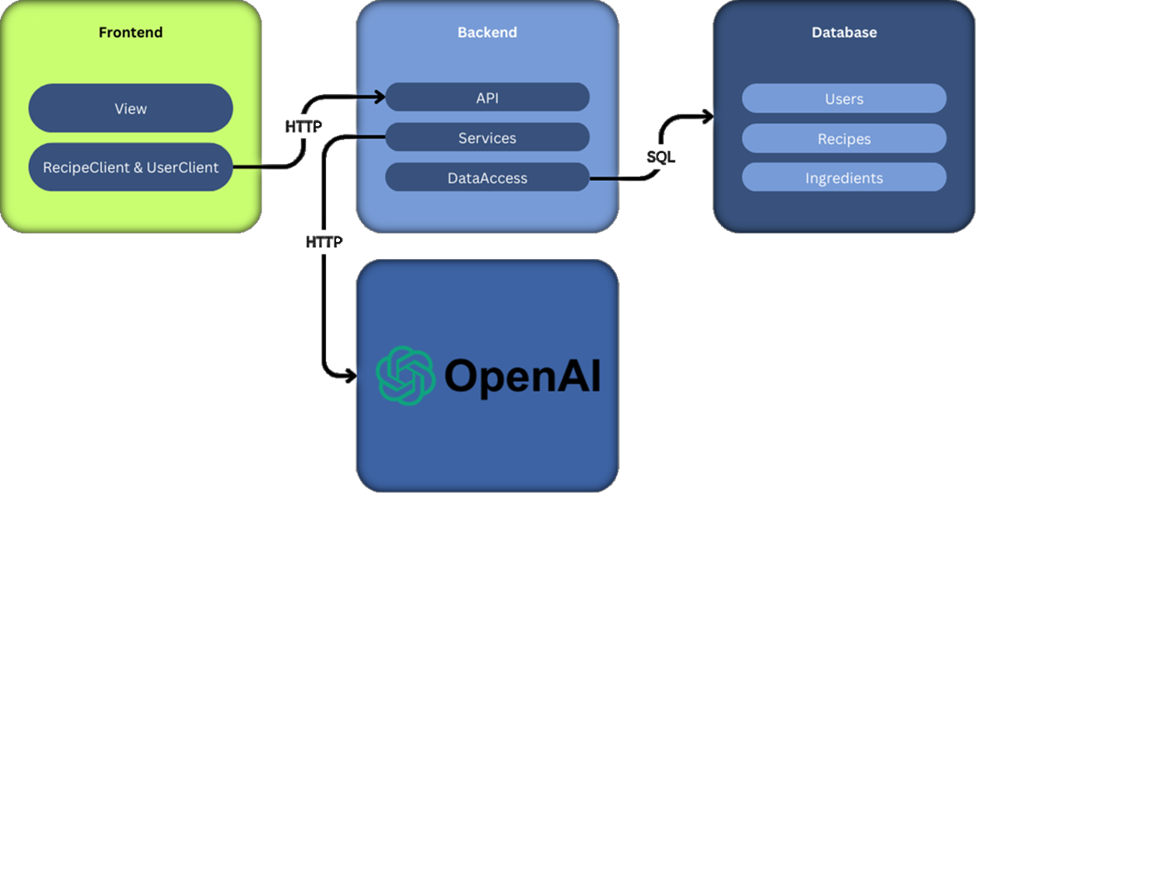
4.1 Architecture

Slide 9
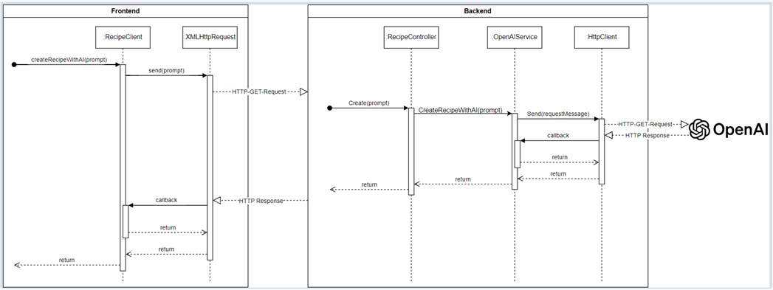
4.1.1 Example
OpenAI Sequence Diagram

Slide 10
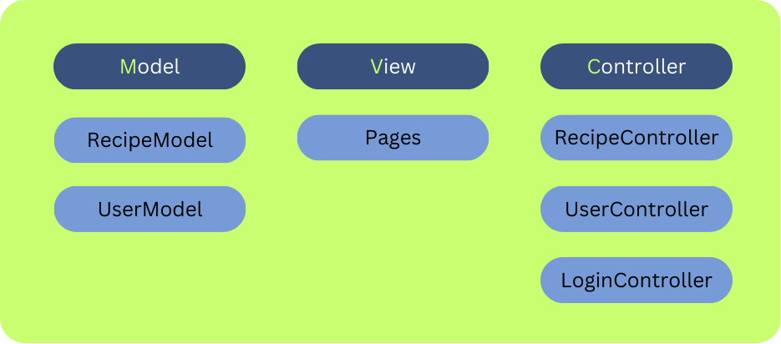
4.2 Applied Design Patterns
Model View Controller (MVC)

Slide 11
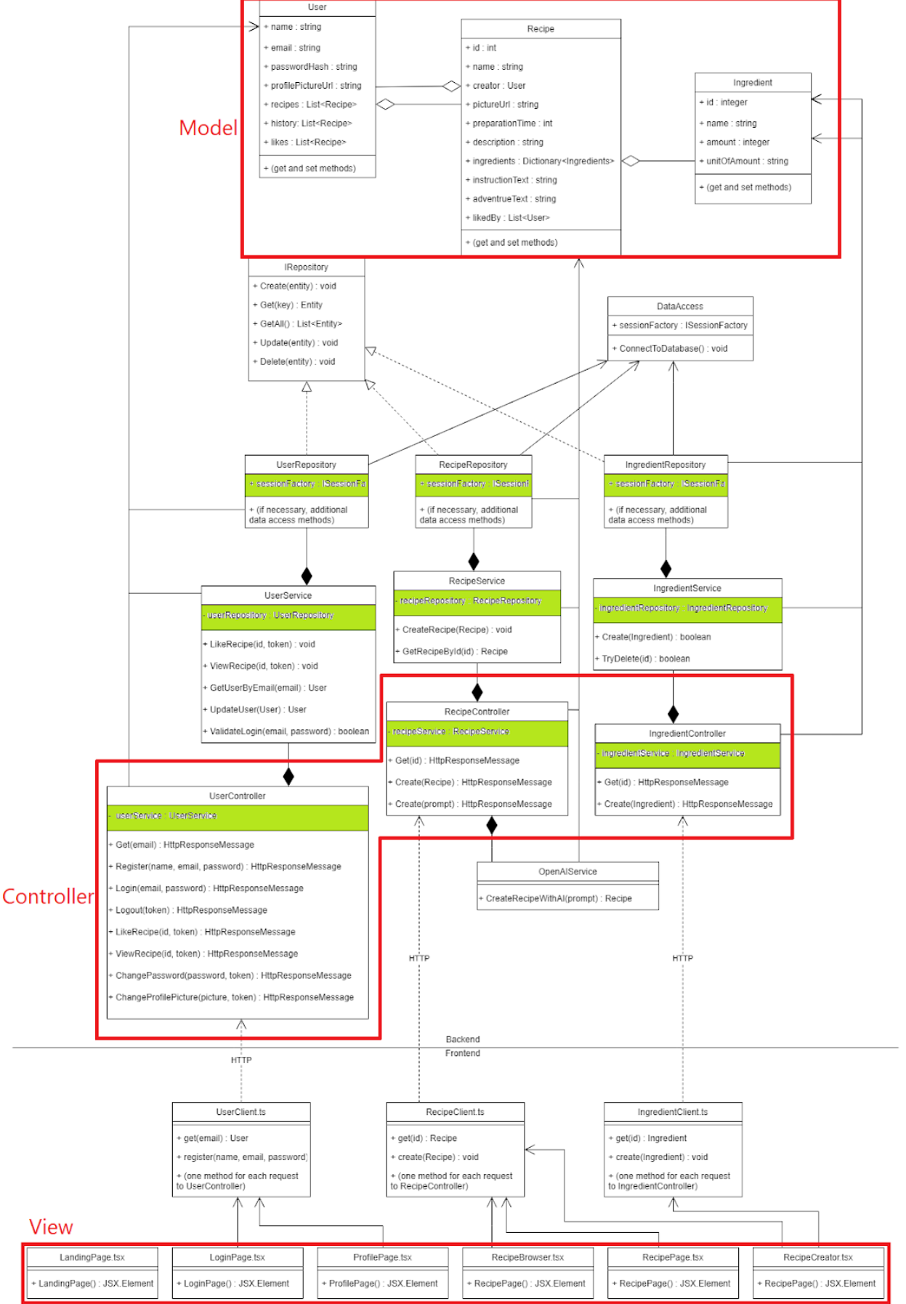

Slide 12
4.2 Applied Design Patterns
Dependency Inversion / Dependency Injection
- Decoupling of classes
- Classes only define dependency types; concrete instances are passed via constructor. + Easy module replacement due to decoupling.
+ Simplifies testing by enabling easy dependency mocking.

Slide 13
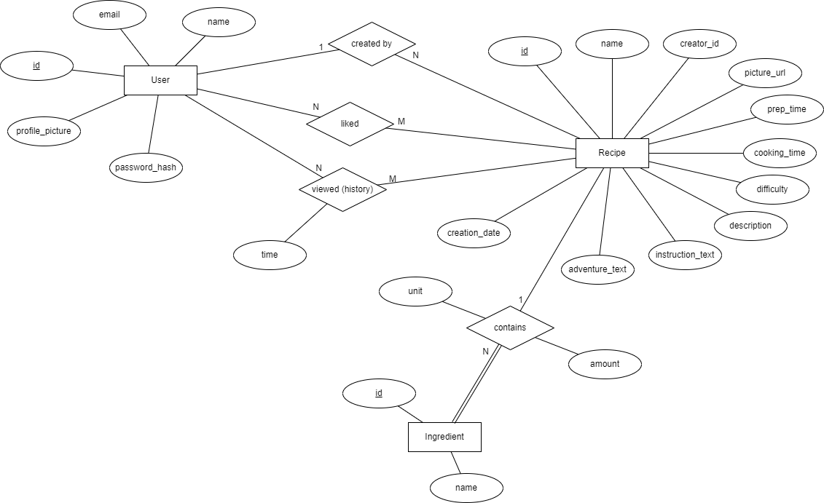
4.3 Database design
Schaffe, schaffe WebApp baue !

Slide 14
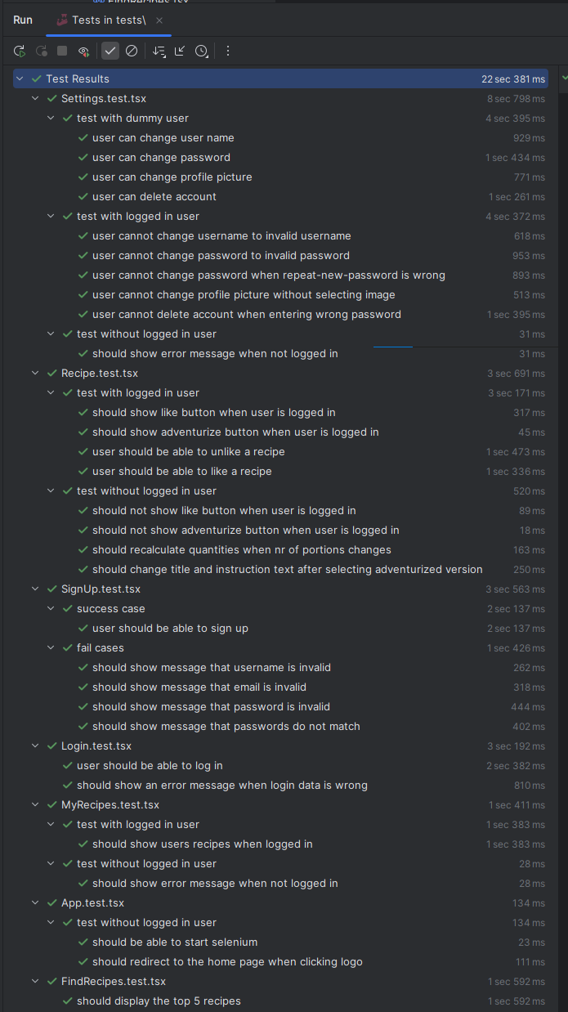
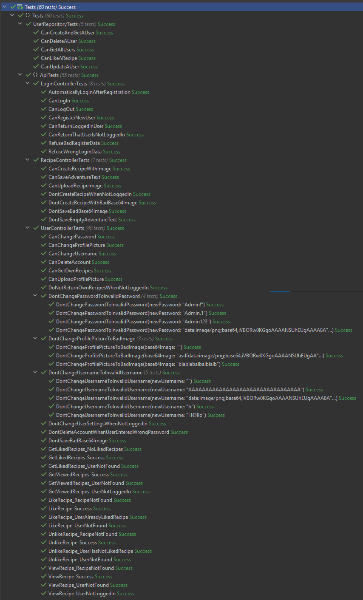
5 Quality Assurance
5.1 Test Coverage
Total number of tests: 90
30 End-To-End tests
5 Integration tests
55 Endpoint/Unit tests
Frontend Tests
Backend Tests

Slide 15
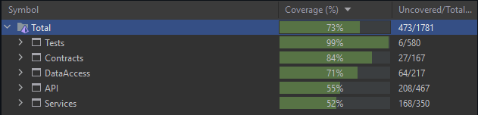
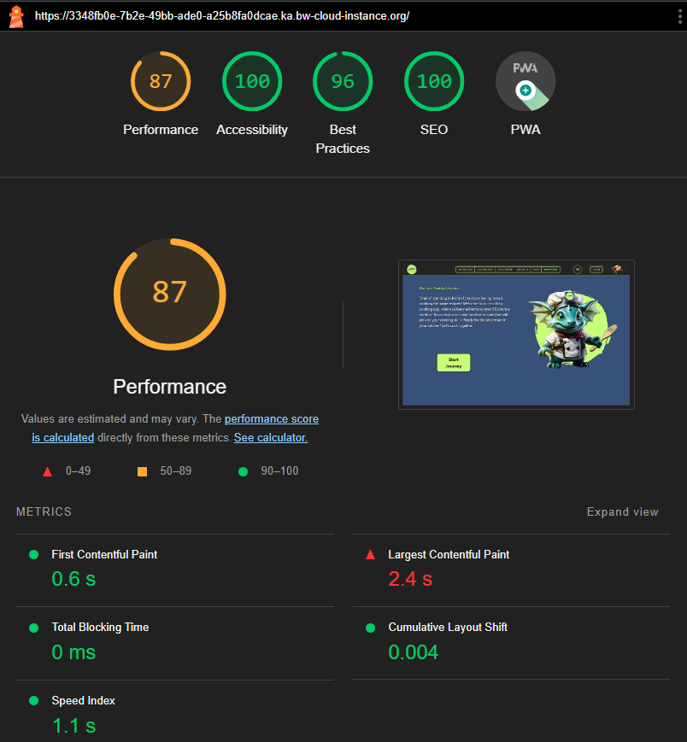
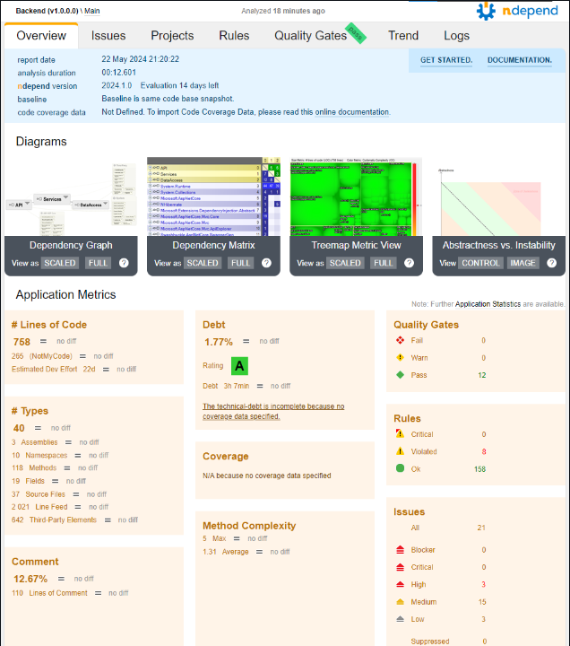
5.2 Metrics
We use the web extension Lighthouse to evaluate our website in regards to its rendering and response performance. The following image contains the result of our application.
For test coverage we use DotCover
(integrated in the Rider IDE)
To Check our Code Quality, we use NDepend.
Royal with cheese.

Slide 16
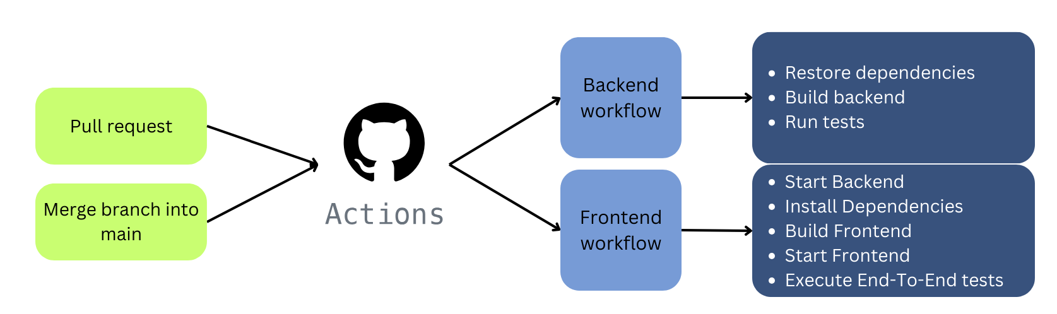
5.3 CI/CD Setup
1,073 recorded workflows:
952 successes
489 pull requests
463 pushes
117 failures​
93 pull requests​
24 pushes​
4 canceled​
4 pull requests​
​
=> 87,71% success rate
C stands for Carlos!

Slide 17
6 Live Demo

Slide 18
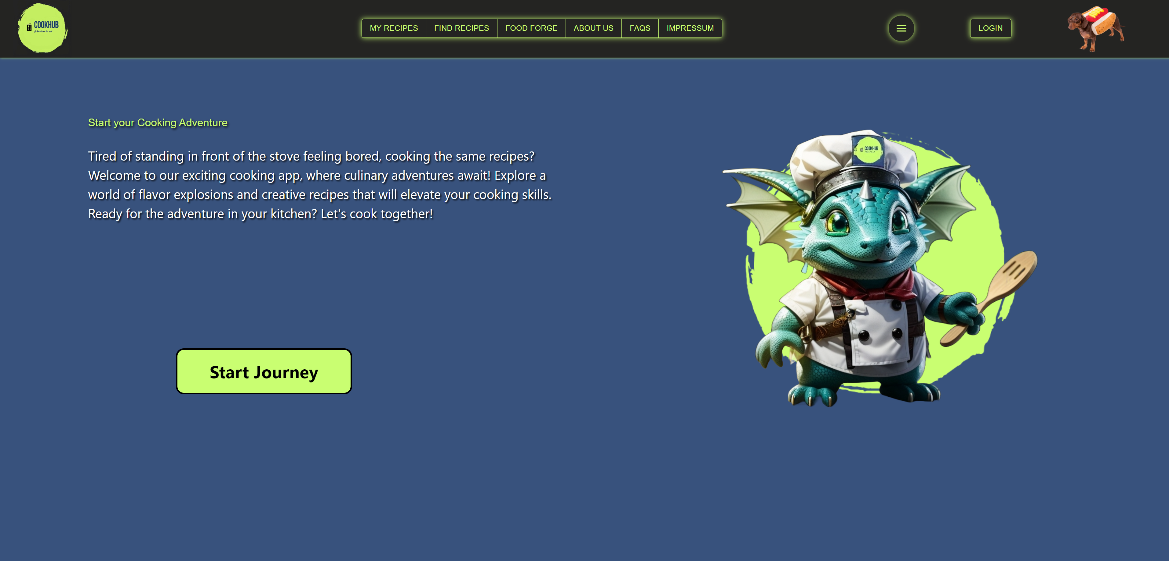
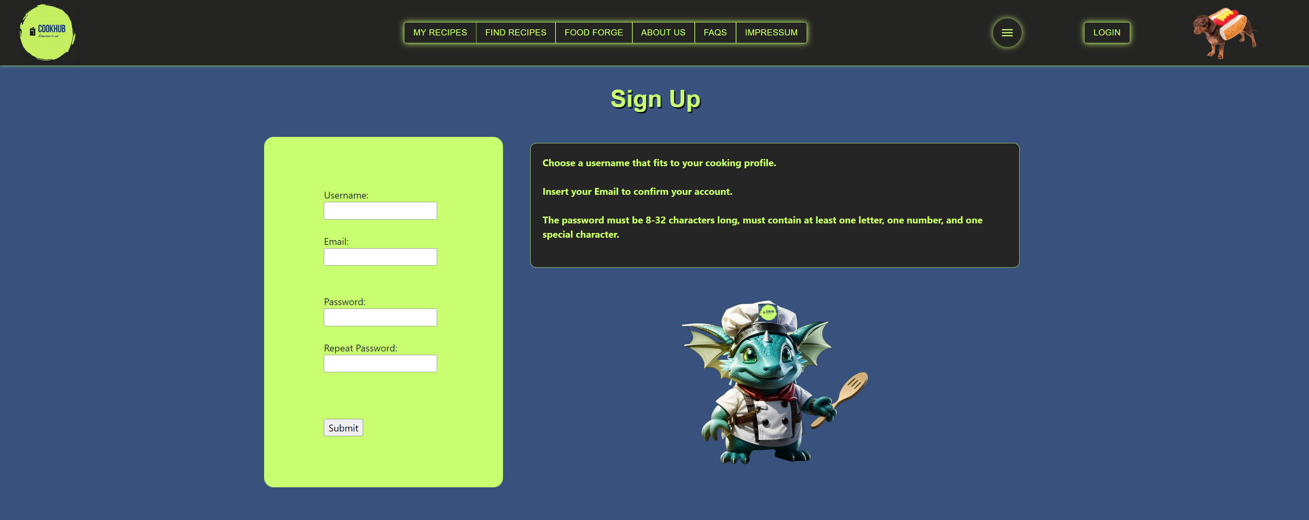
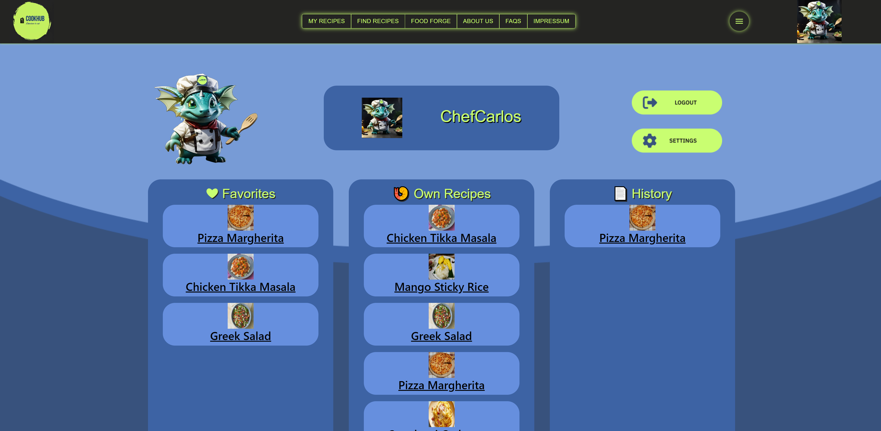
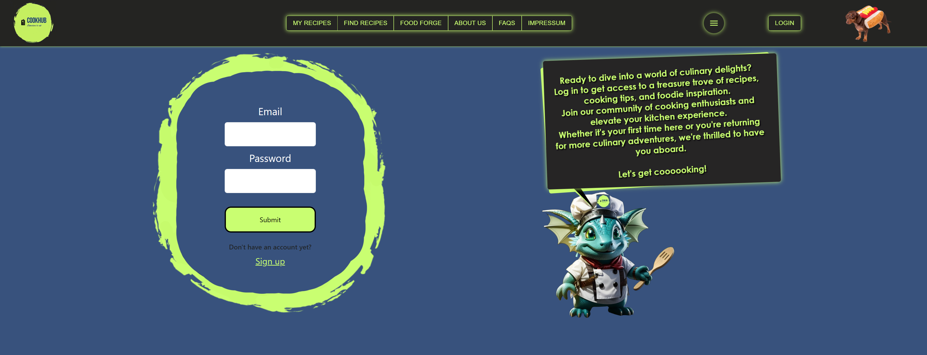
6 Demo-Highlights
SignUp Page
Landing Page
Login Page
Profile Page

Slide 19
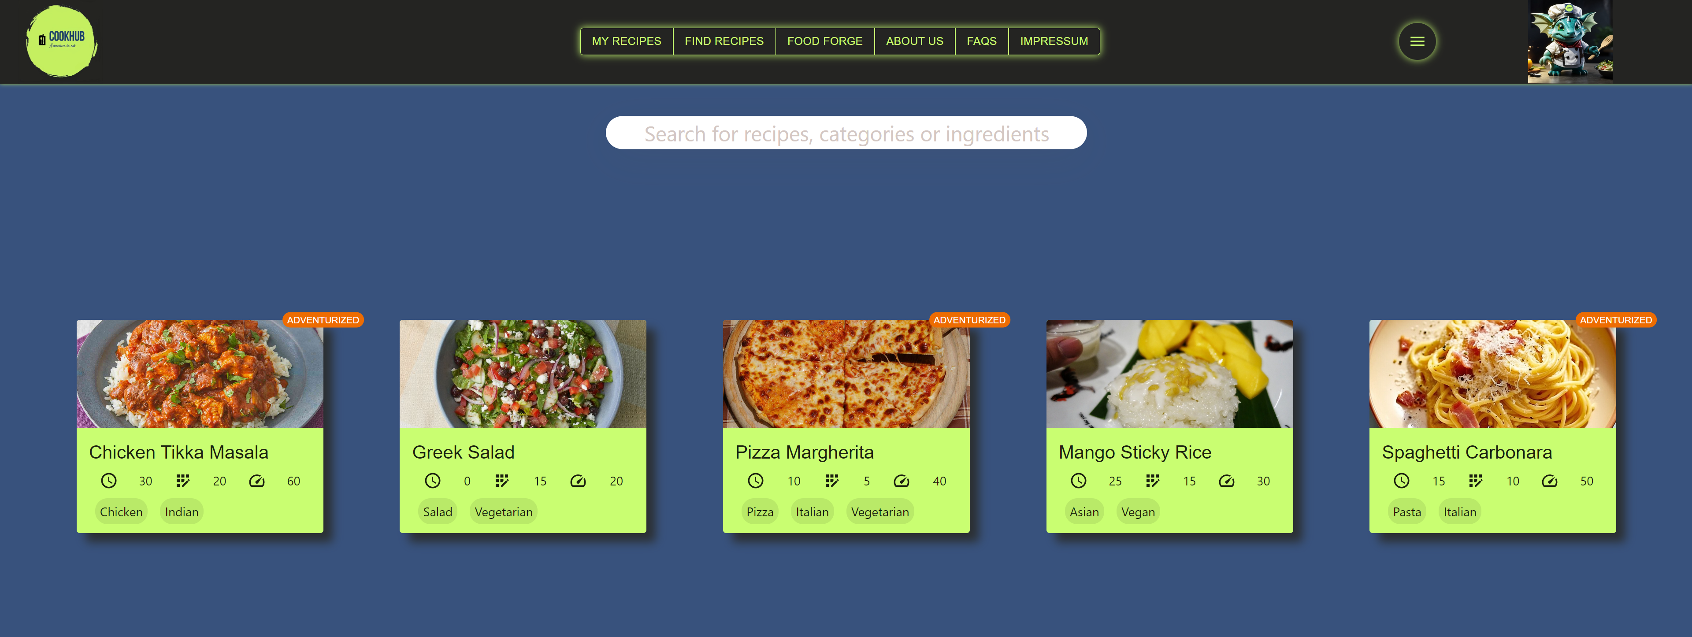
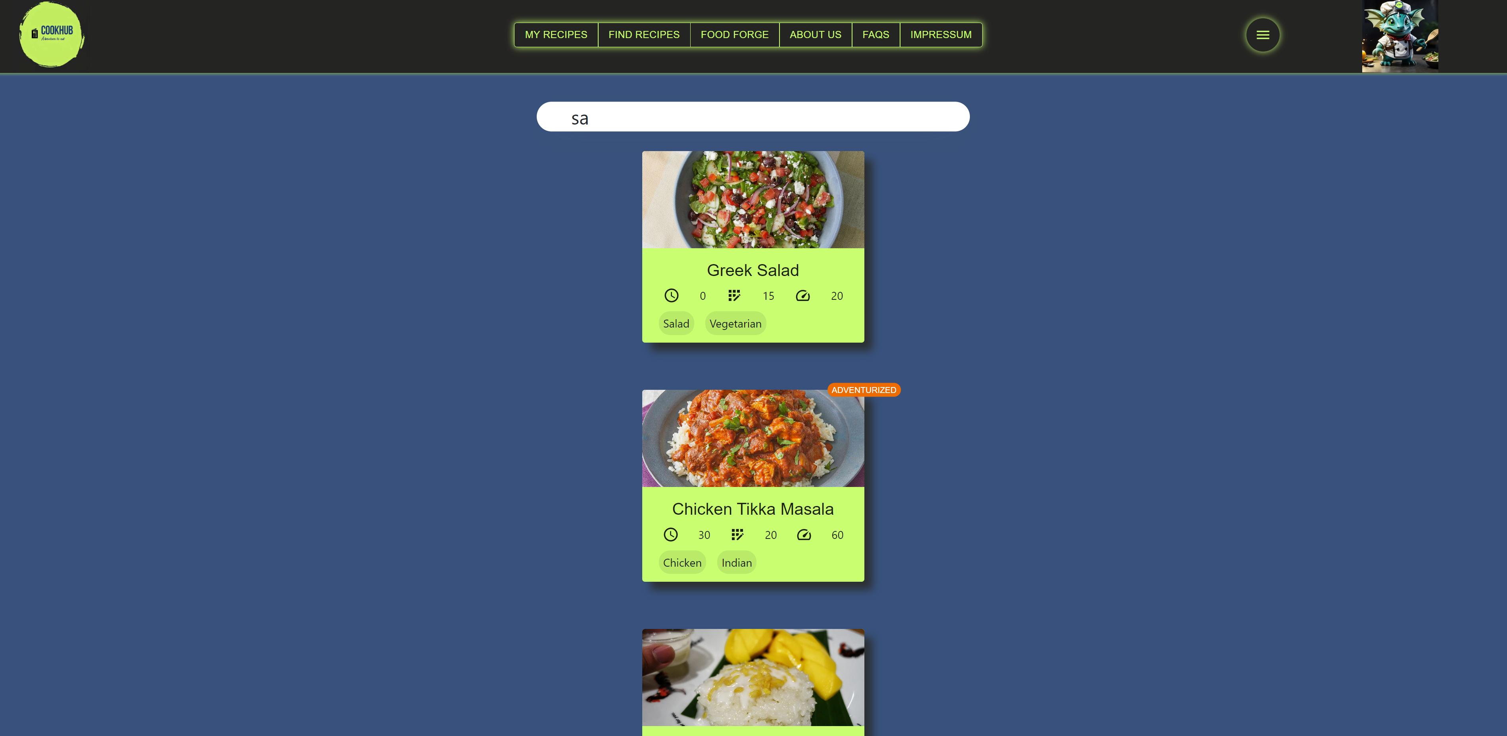
FindRecipes Page
FindRecipes page: Text input

Slide 20
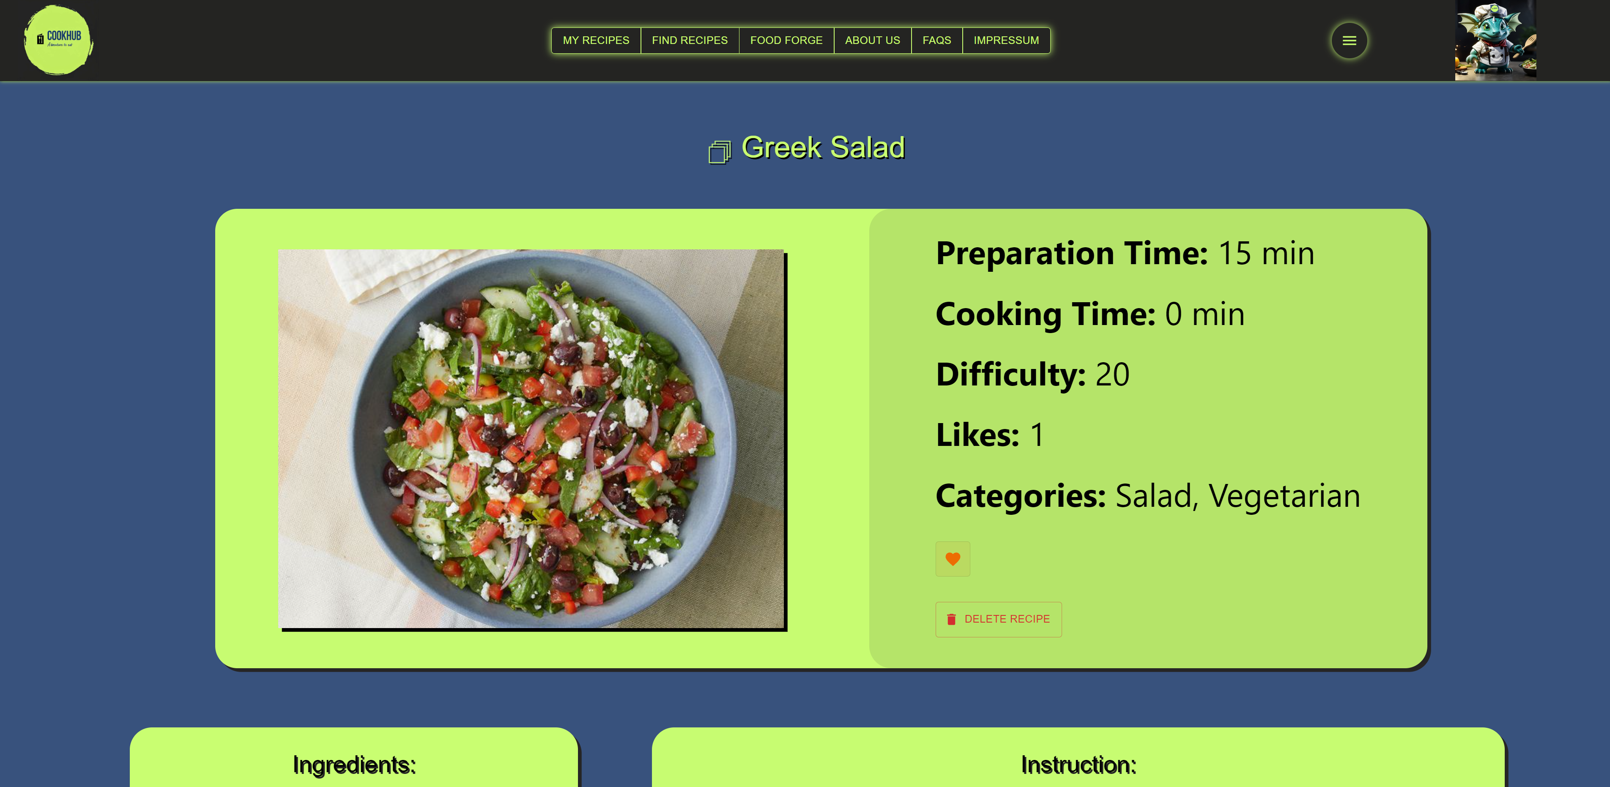
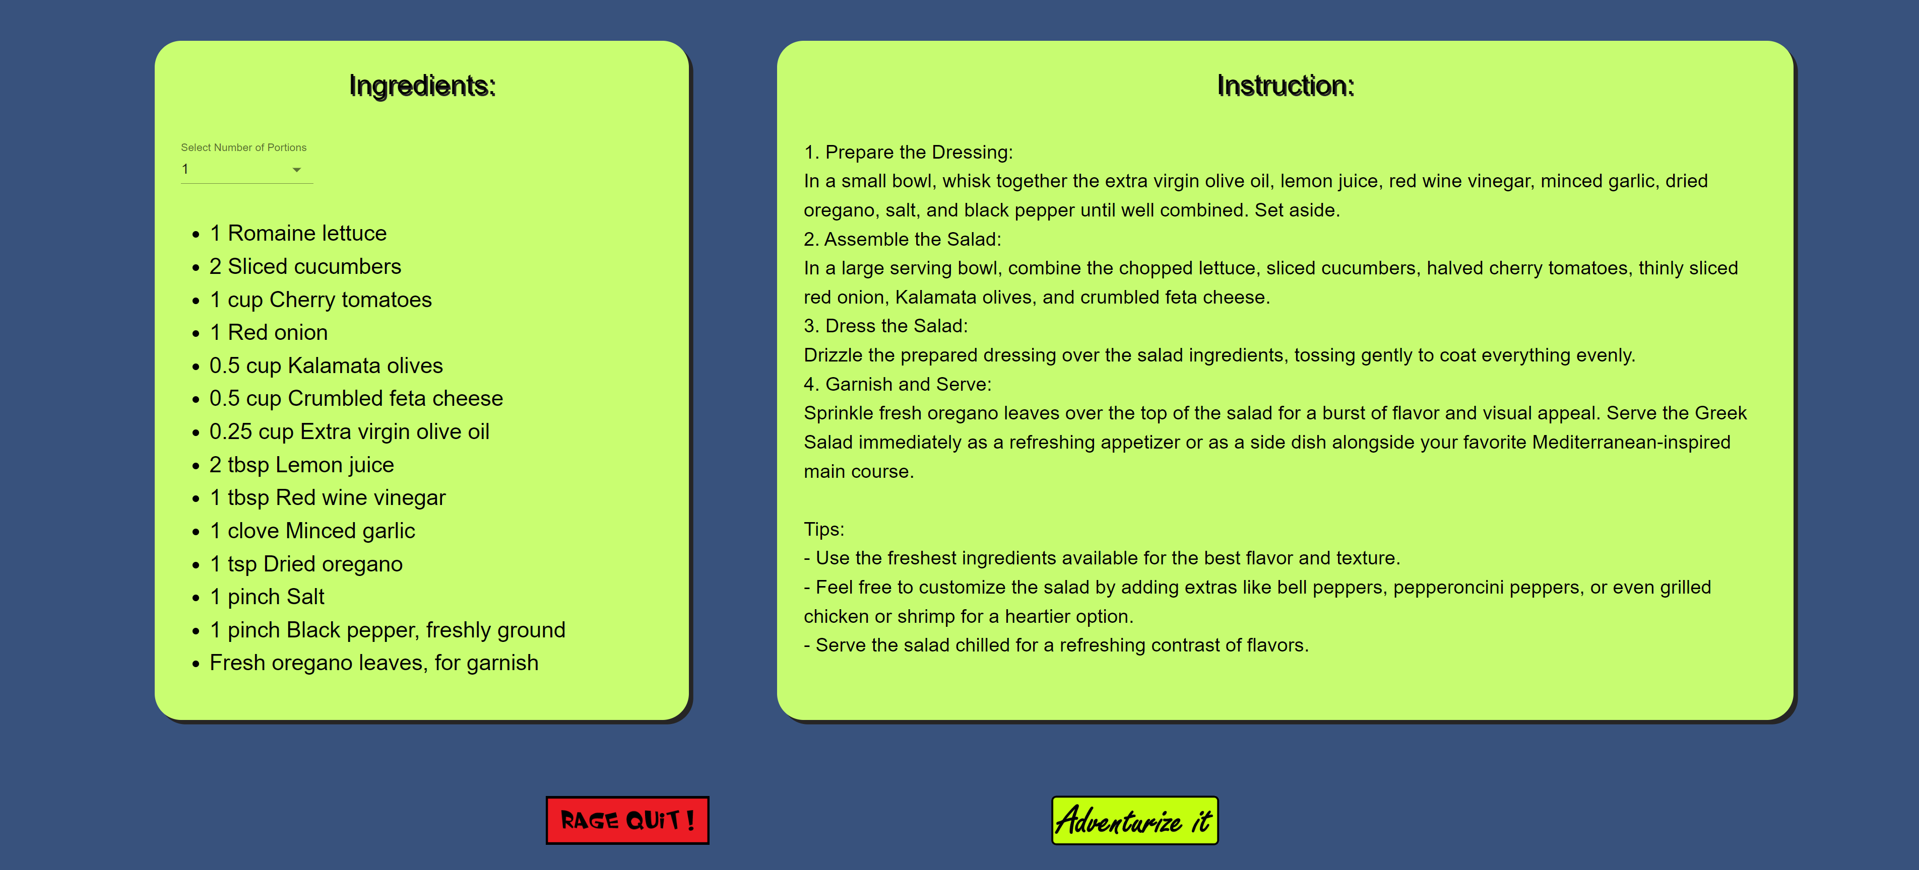
Specific Recipe

Slide 21
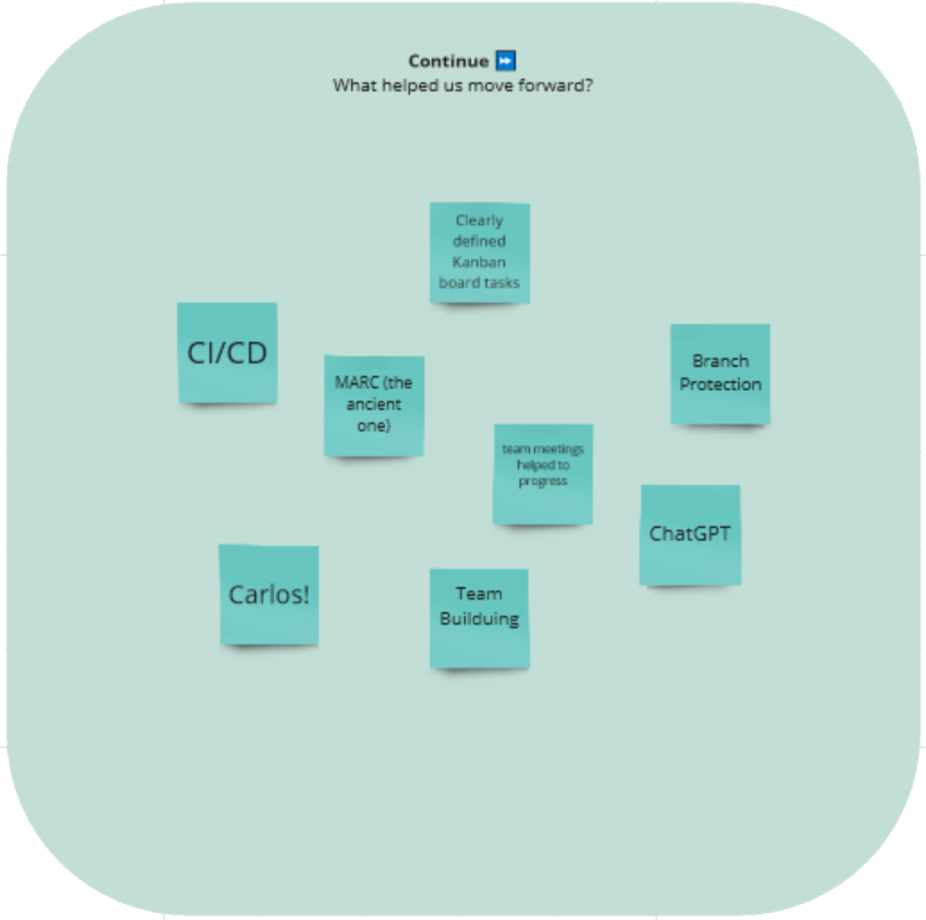
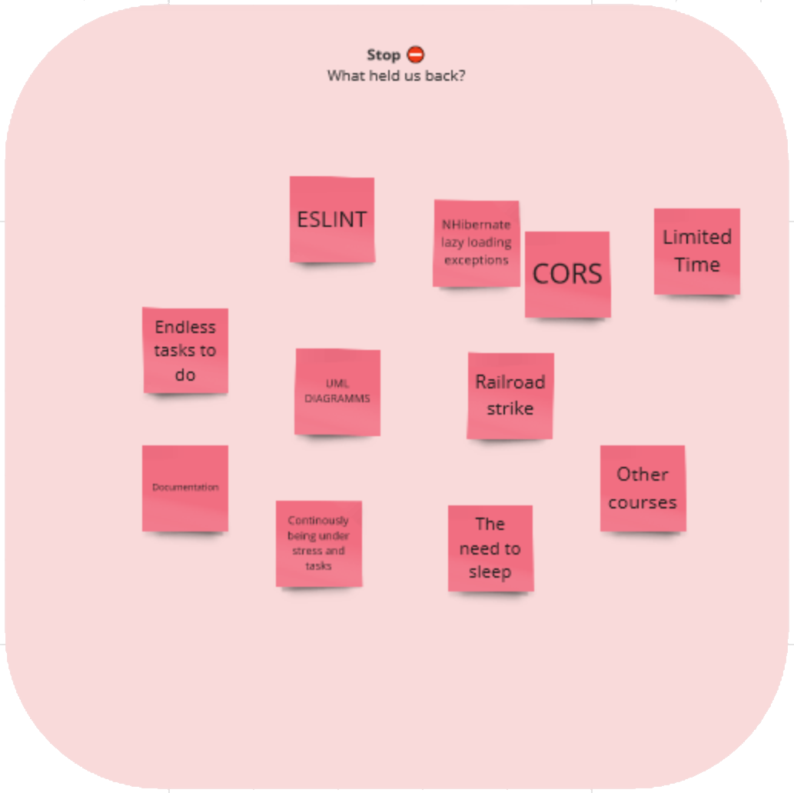
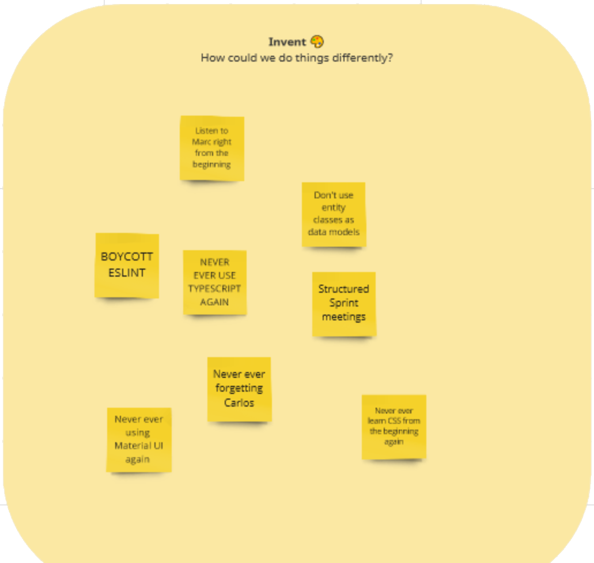
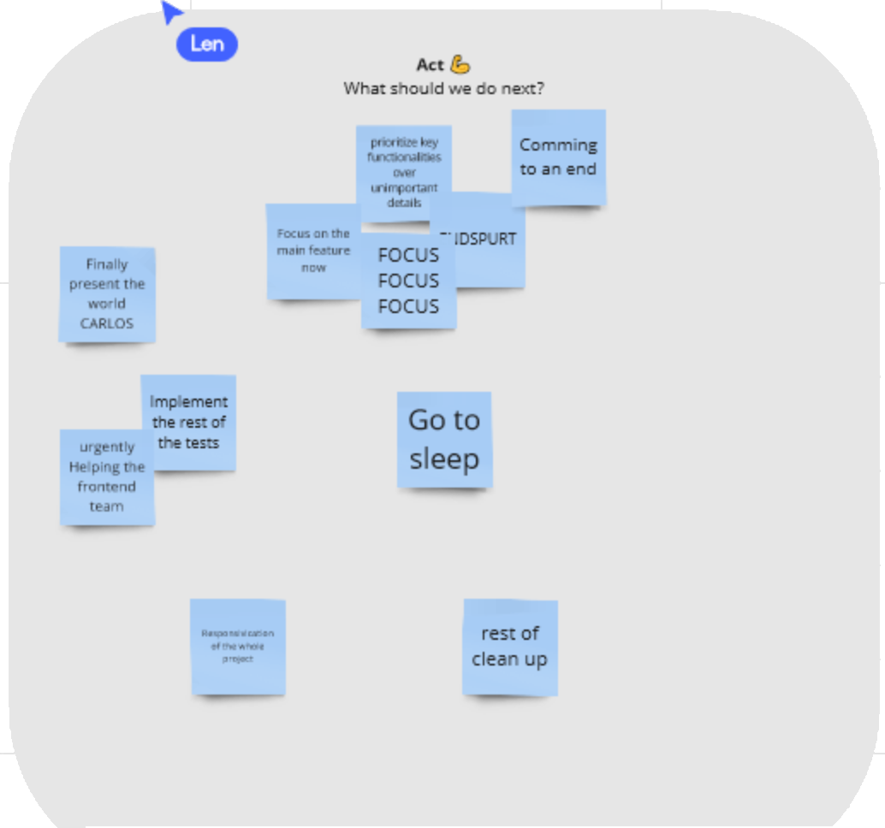
7 Project Management
Retrospective summary:
What helped us:
Clearly defined kanban tasks, automated tests
What held us back:
Difficulties with some technologies, limited time
What we could have done better:
Time management, more structured meetings

Slide 22

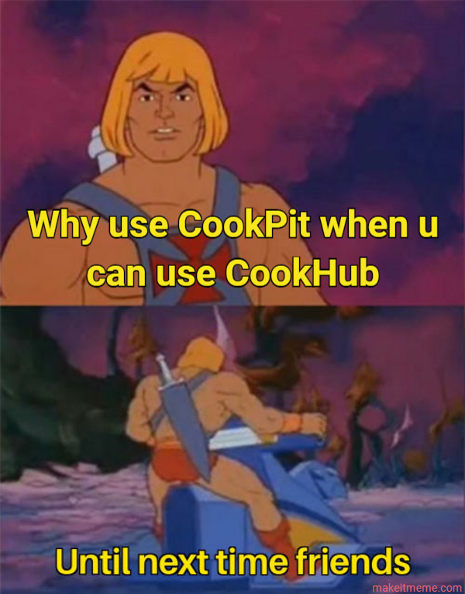
Thank you for listening !

Slide 23





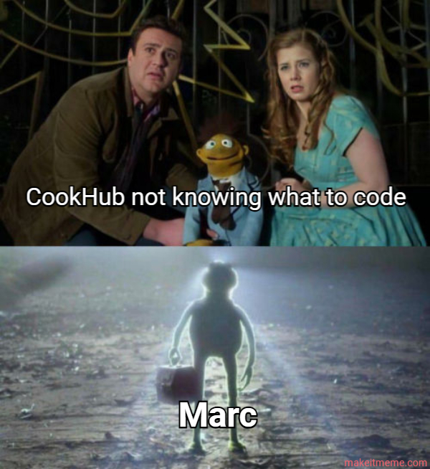



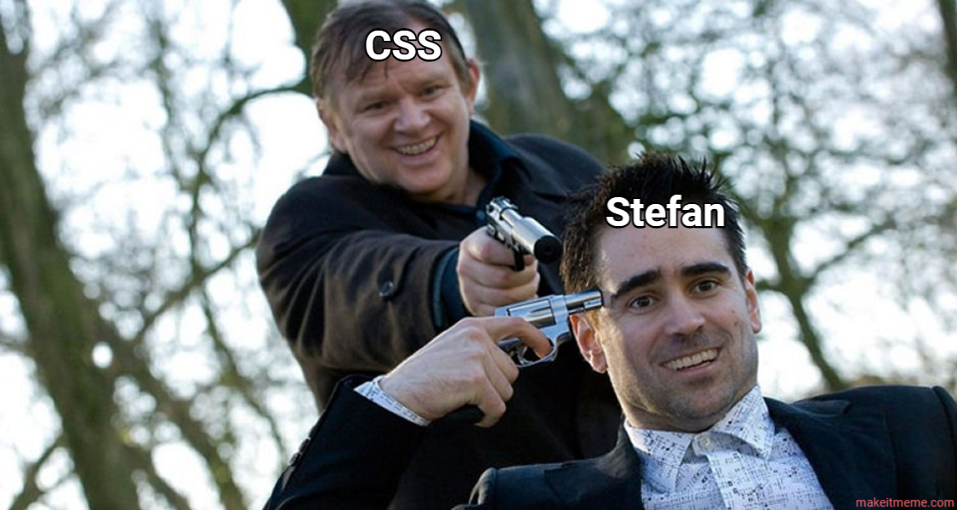
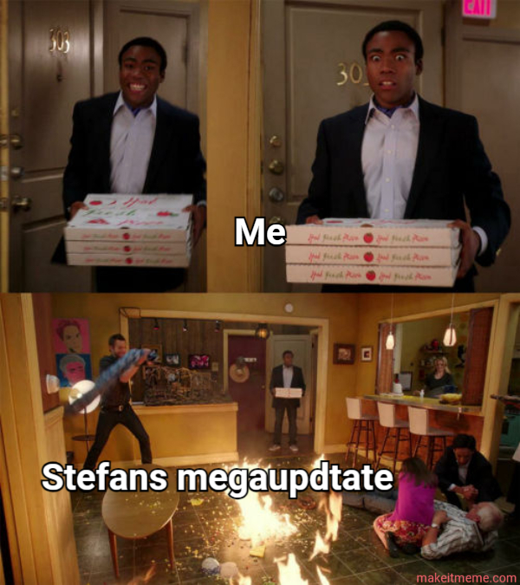
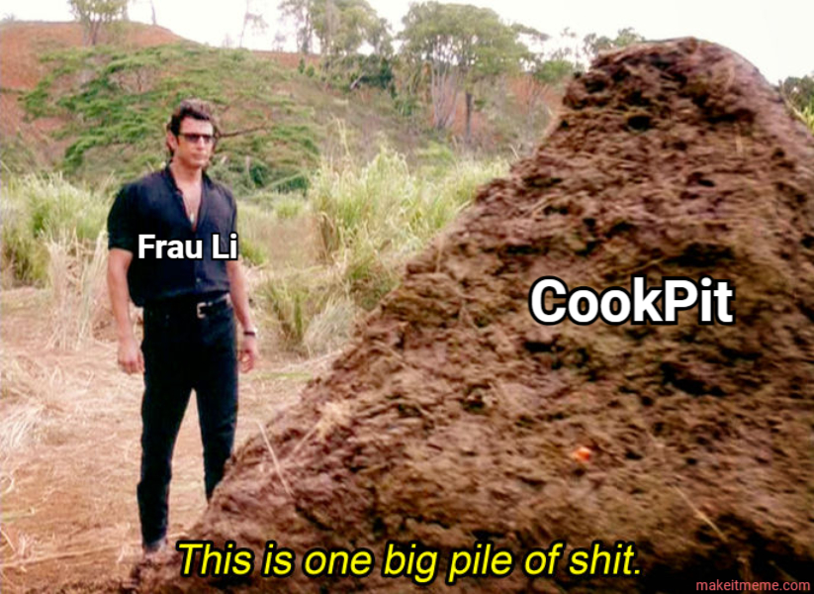
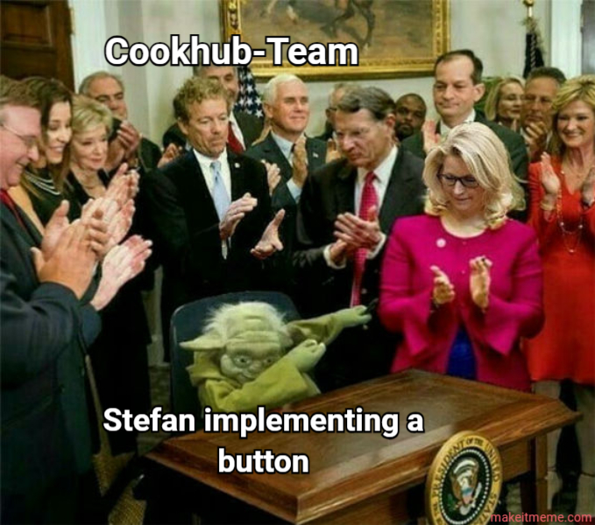
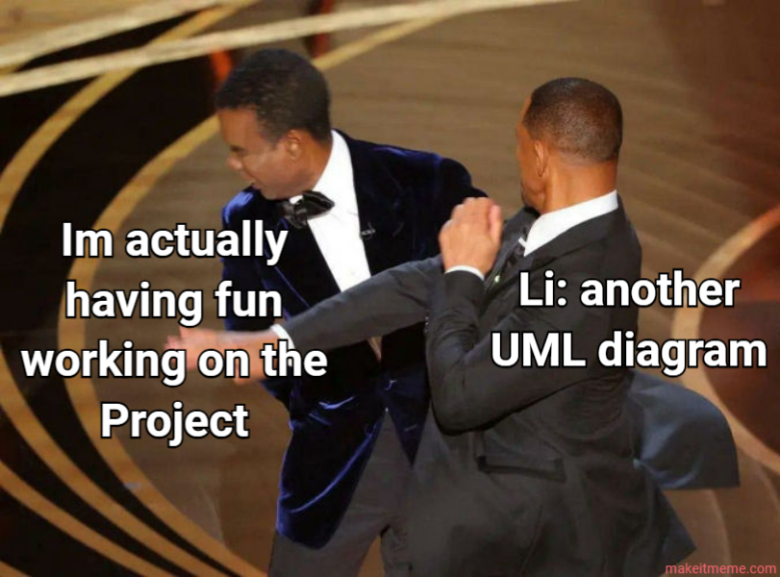

BEST OF TEAM BUILDING

